Slide 1
Lecture 10: Referee analytics

Slide 2
Goals
Overview of referee literature
Responses to cues
Effects on game
Tools
Visualizations
Natural experiments
Linear and logistic regression
Differences in Differences
Generalized additive models

Slide 3
Pre-lesson activity
Soccer: extra time (Garicano et al)
NFL: sideline (Lopez)
Soccer: empty stadia (Priks)

Slide 4
For your article
Read abstract, methods, results, discussion.
Describe goal
Methods and notation
Findings
Practical and statistical significance

Slide 5
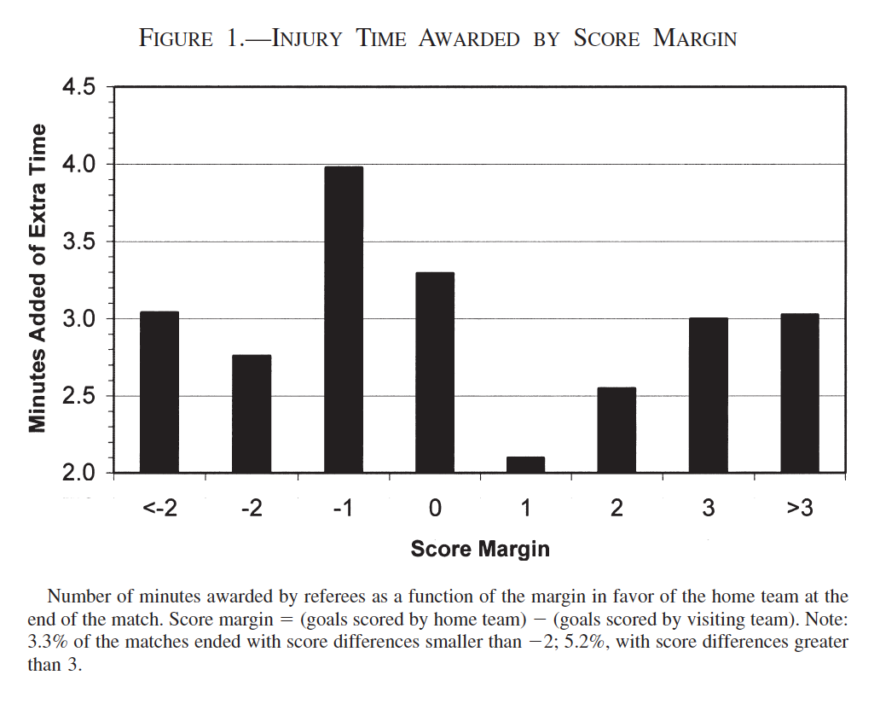
Summary
Soccer: extra time (Garicano et al)

Slide 6
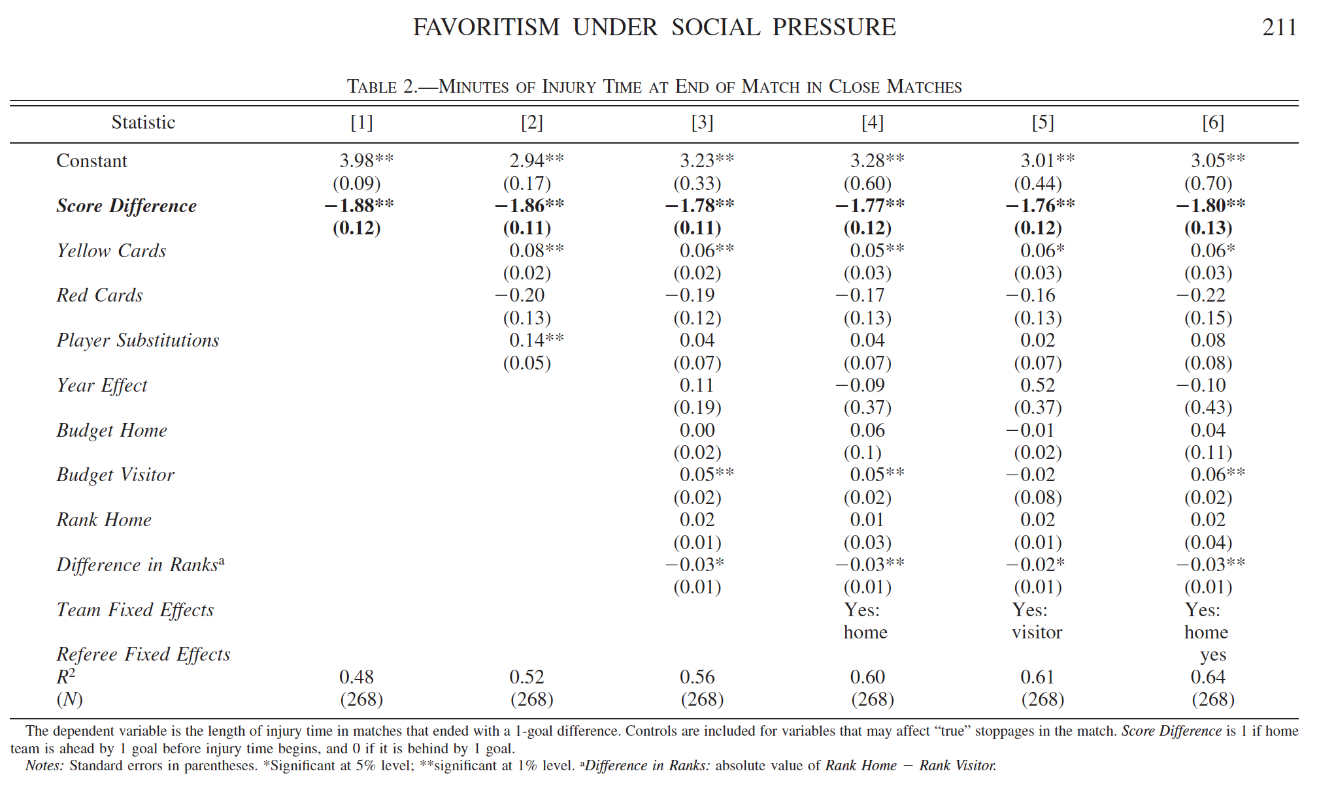
Summary
Soccer: extra time (Garicano et al)

Slide 7
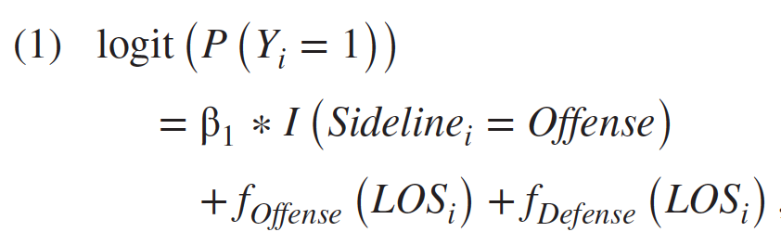
Summary
NFL: sideline (Lopez)
Generalized additive model:
-fixed effect for sideline
-useful for non-linear associations by LOS
-allows for `wiggliness`
-more flexibility

Slide 8
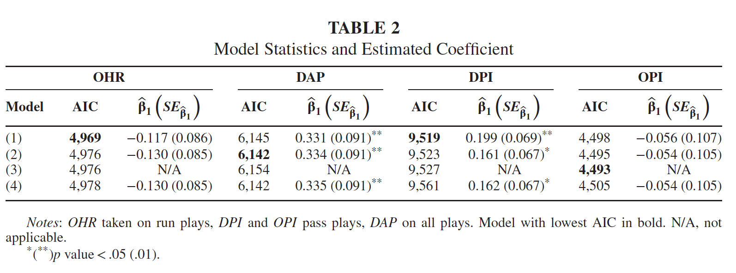
Summary
NFL: sideline (Lopez)

Slide 9
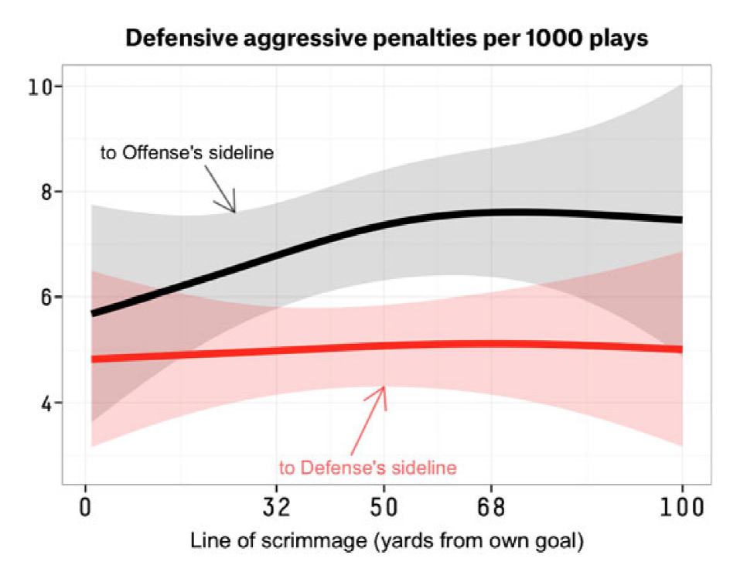
Summary
NFL: sideline (Lopez)

Slide 10
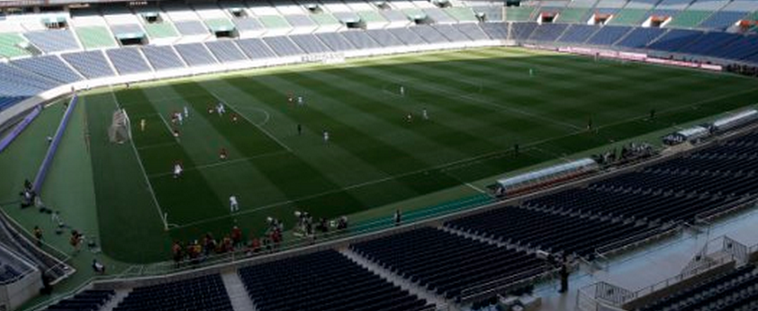
Summary
Soccer: empty stadia (Priks)
Natural experiment: serendipitous scenarios in observational data where assignment to treatment approximates a randomized design or a well-controlled experiment
-What’s the benefit?

Slide 11
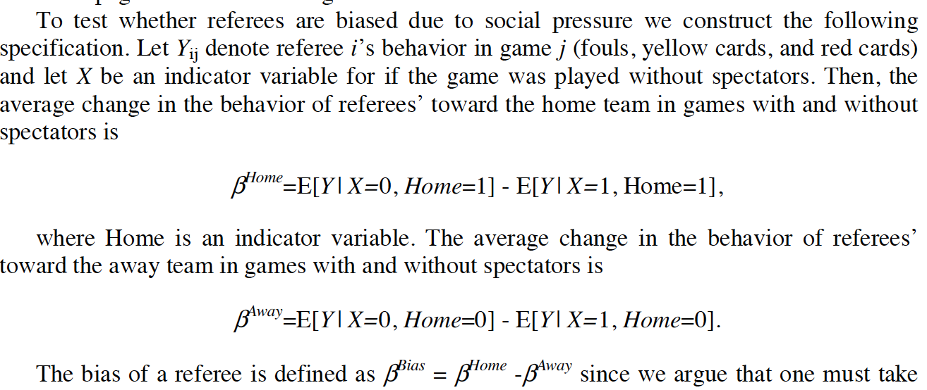
Summary
Soccer: empty stadia (Priks)

Slide 12
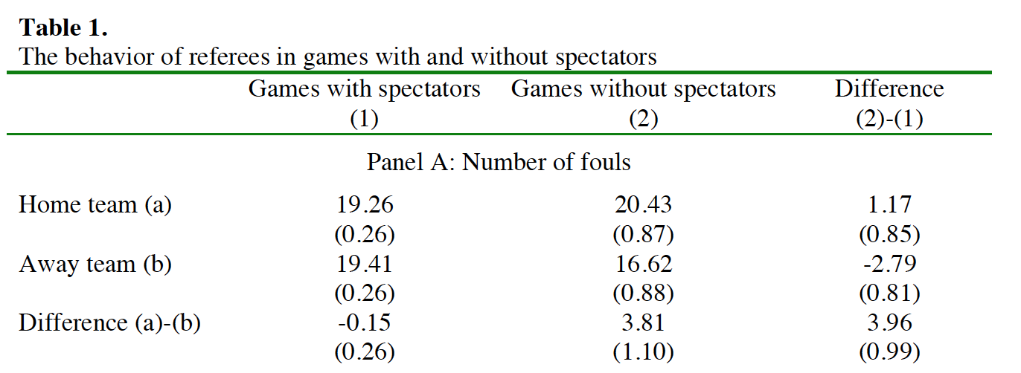
Summary
Soccer: empty stadia (Priks)

Slide 13
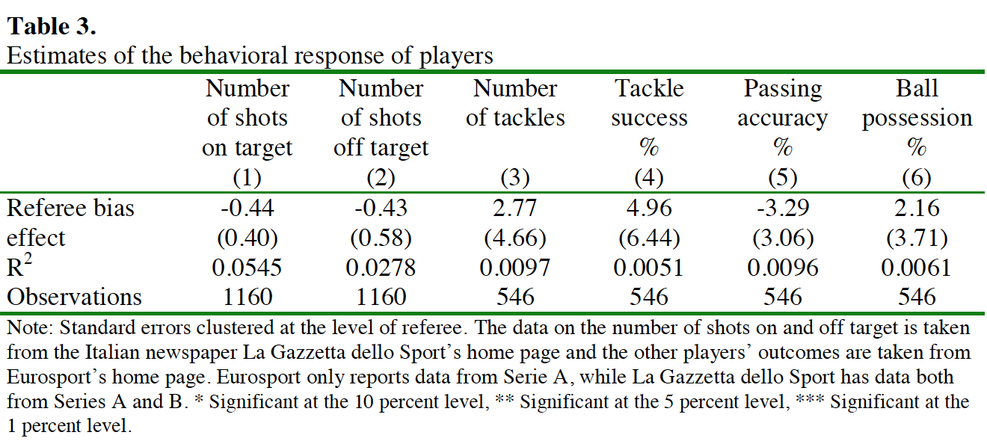
Summary
Soccer: empty stadia (Priks)

Slide 14
Why referees?
Tasked with making impartial decisions
Testing ground for social biases
Data – lots of it
Unique designs of sport

Slide 15
Why not referees?
Confounded data – examples?
Actionable?
Unique designs of sport

Slide 16
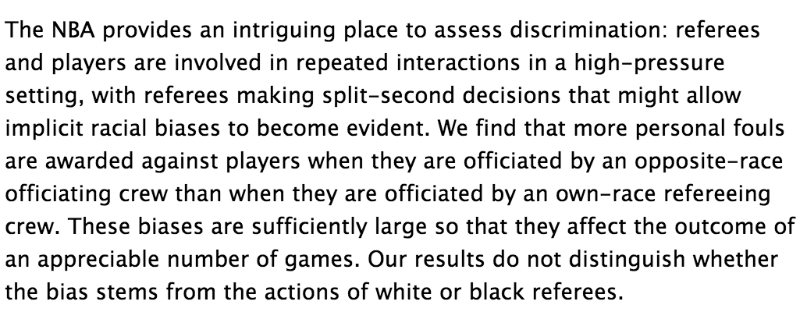
Additional findings, racial bias
Price & Wolfers:

Slide 17
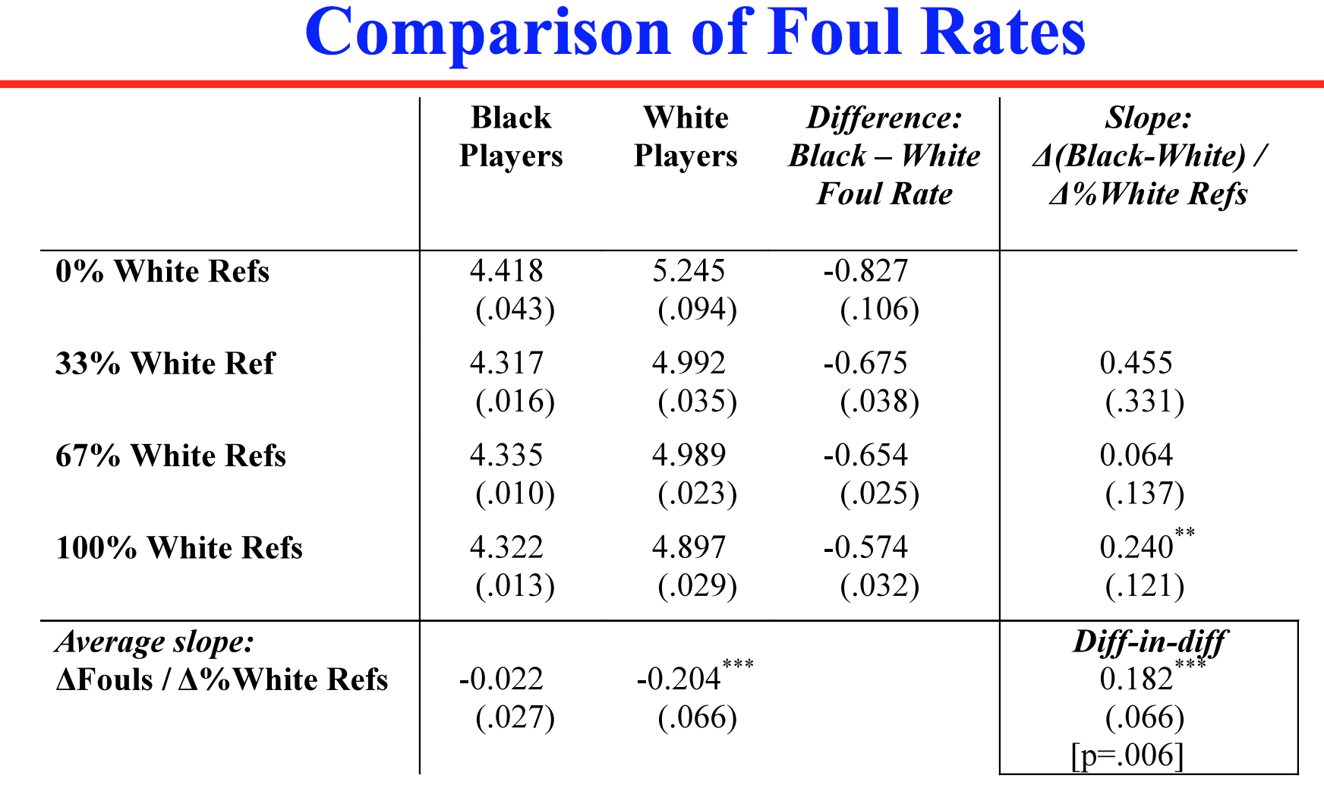
Additional findings, racial bias
Price & Wolfers:

Slide 18
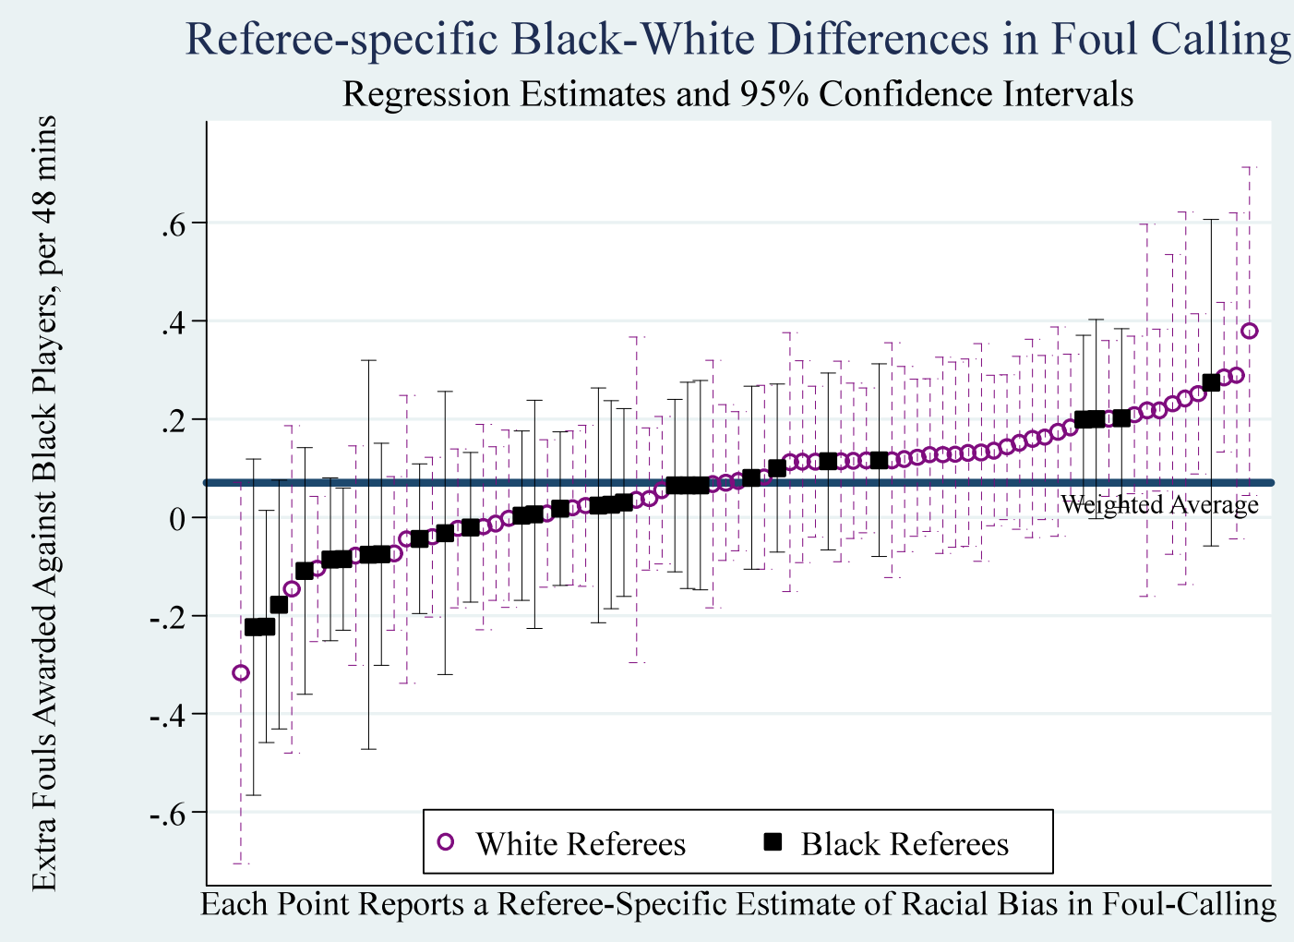
Additional findings, racial bias
Price & Wolfers:

Slide 19
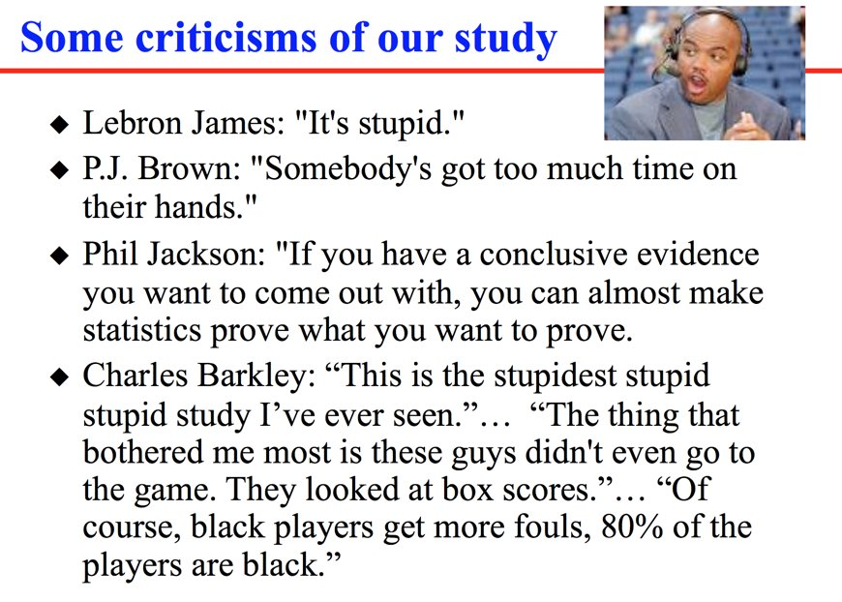
Additional findings, racial bias
Price & Wolfers:

Slide 20
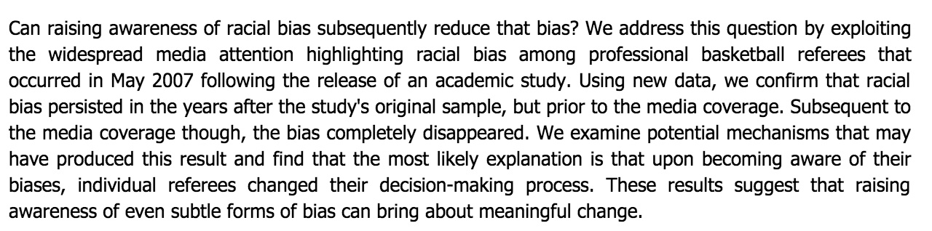
Additional findings, racial bias
Price & Wolfers Part II:

Slide 21
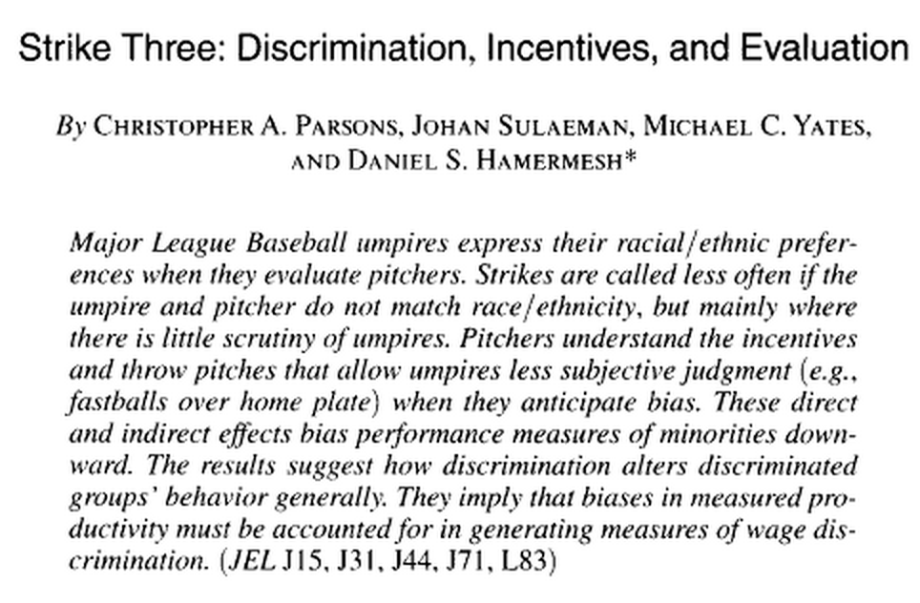
Additional findings, racial bias
Racial bias in MLB (Parsons et al):
MLB bias potentially overstated (Tainsky)

Slide 22
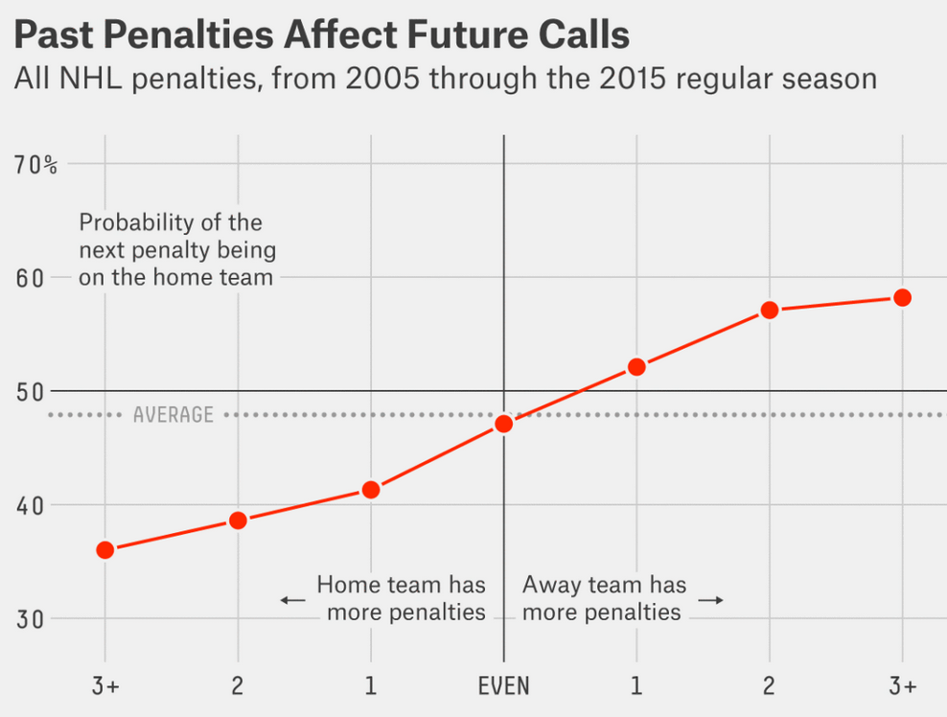
Additional findings, sequential calls
Make-up calls (Lopez & Davis):
But why? What does this suggest?

Slide 23
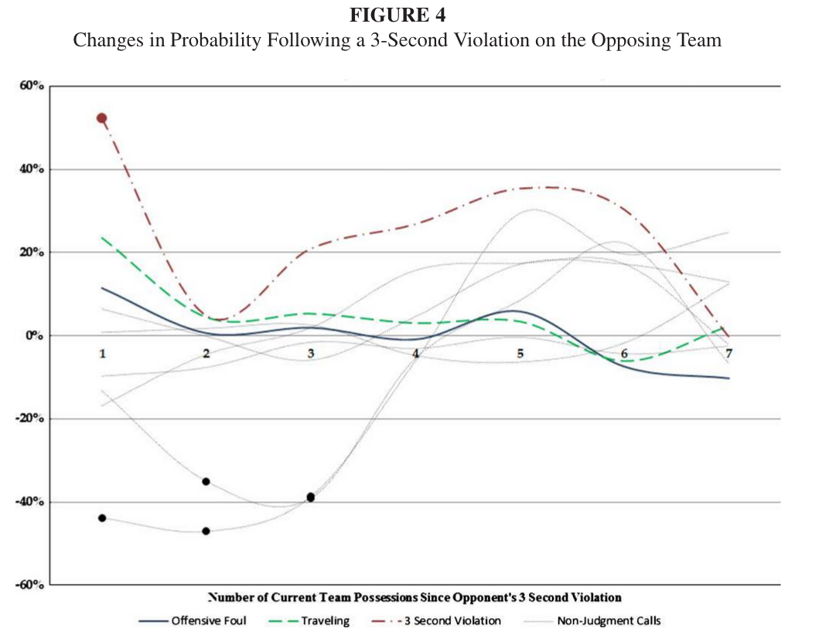
Additional findings, sequential calls
Make-up calls (Gift):
But why? What does this suggest?

Slide 24
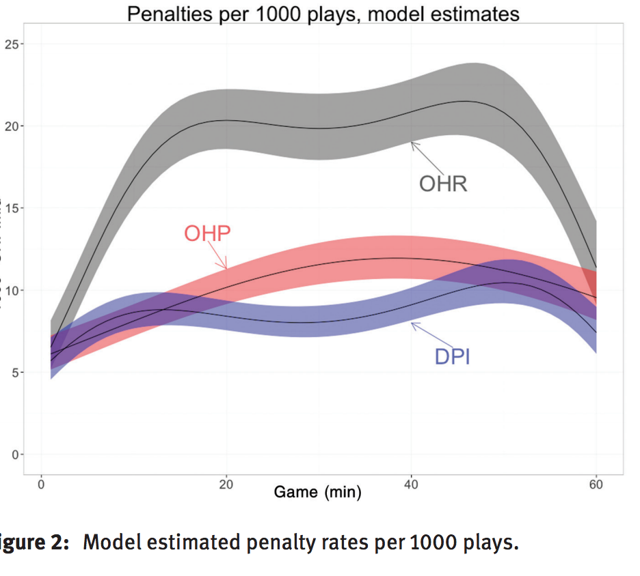
Additional findings, timing matters
Timing of NFL penalties (Snyder and Lopez):
OHR: Holding, run plays
OHP: Holding, pass plays
DPI: Defensive pass interference
But why? What does this suggest?

Slide 25
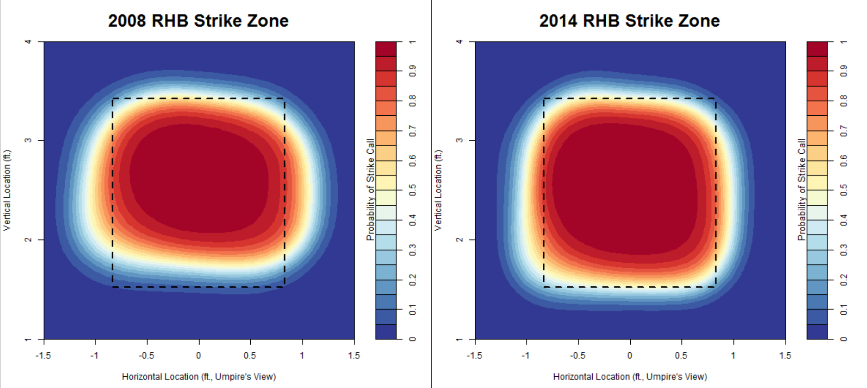
Additional findings, monitoring
Monitoring improves performance (Mills):
But why? What does this suggest? Effects on baseball?

Slide 26
More fun ones
Mills: MLB strike zone by position, count
Zitzewitz: Favorable Olympic judging
Nevill: Crowd noise experiment, ref experience
Frank & Gilovich: Uniform color
Gift & Rodenberg: Napolean complex

